Slide 2

The Team – Code Breakers
Theme – Health

Slide 3

The Problem
Domain: Foodborne Illnesses in South Africa
Broader Context:
1 in 4 South Africans suffers from foodborne diseases annually, with outbreaks linked to poor food handling, contaminated water, and lack of refrigeration in informal settlements.
Cape Town’s townships and informal food vendors face unique challenges: inconsistent electricity (load-shedding), limited access to clean water, and gaps in food safety education.
Vulnerable populations, including immunocompromised individuals (e.g., HIV/AIDS patients), are at higher risk of severe outcomes from food poisoning.
What are you solving with AI?

Slide 4
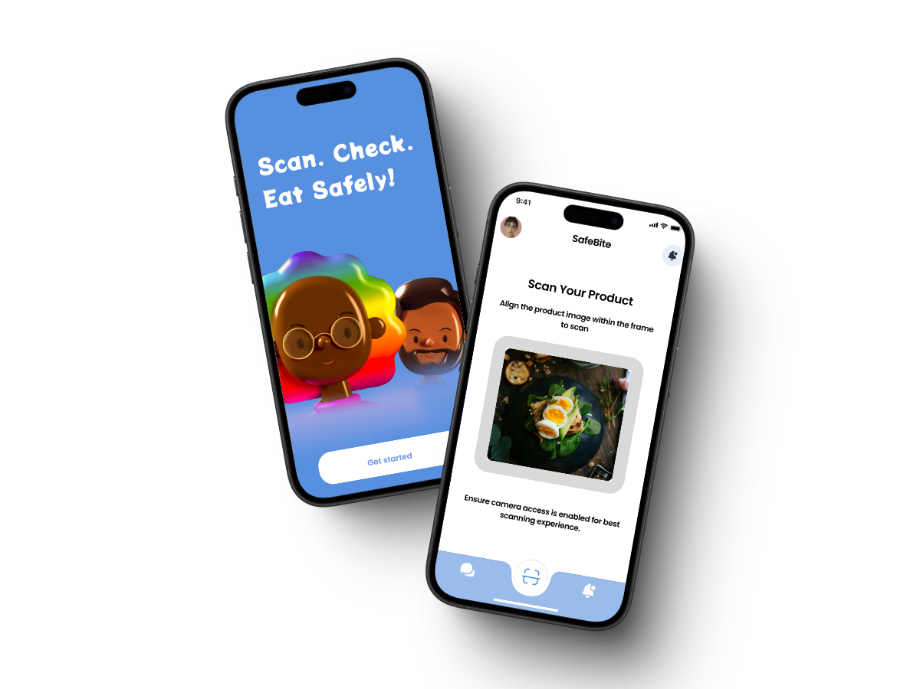
AI Concept
Solution: SafeBite ZA – A hyper-localized AI platform designed to combat food contamination and foodborne illnesses in Cape Town’s communities.
Real-Time Contamination Detection: Use smartphone cameras and low-cost IoT sensors to scan food for contaminants (e.g., _Listeria_ in processed meats, _E. coli_ in water). Example: Scanning "biltong“ (dried meat) detects mold or bacterial growth via AI image analysis and odor simulation (trained on SA-specific food databases).
Community Reporting & Crowdsourcing: Users report unsafe street food vendors or contaminated products (e.g., expired _"samp and beans"_ sold in spaza shops). - Real-time heatmaps alert Cape Town Health Department to high-risk areas like Khayelitsha or Mitchells Plain.
Multilingual Education: AI-generated food safety tips in isiXhosa, Afrikaans, and English (e.g., “How to store _pap_ safely”). - Gamified quizzes: “Earn points for proper handwashing techniques!”

Slide 5
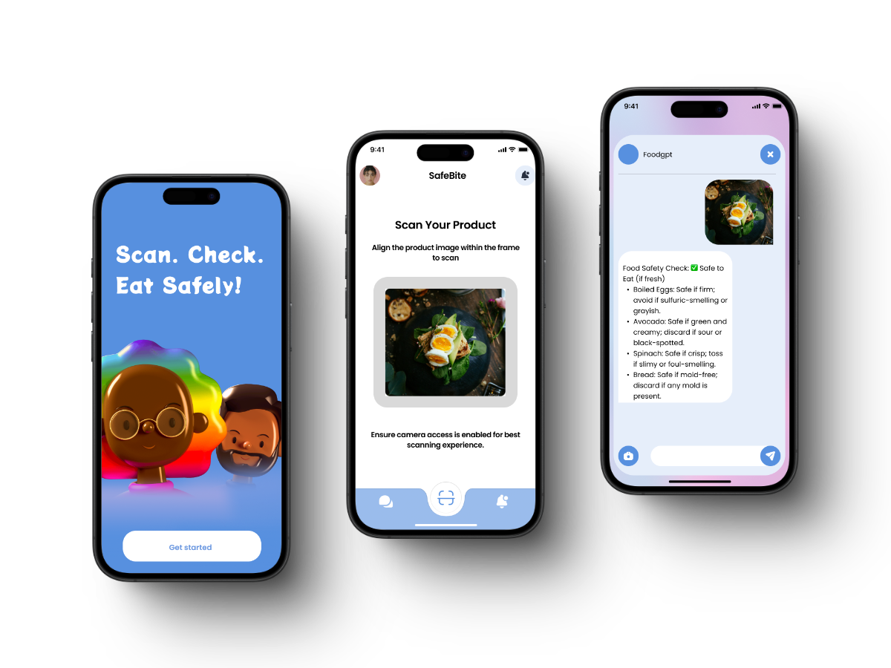
UI/UX Design

Slide 6
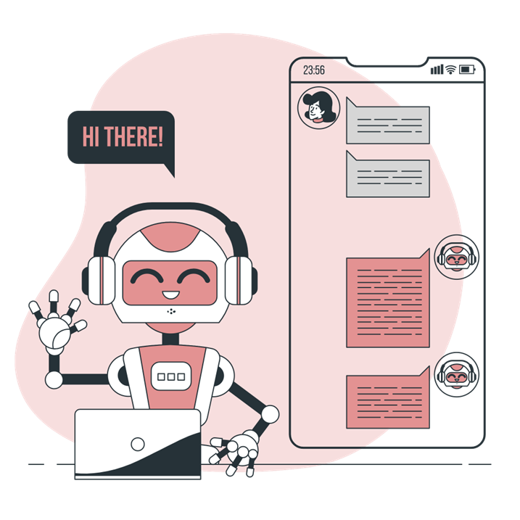
Use of Artificial Intelligence
Computer Vision:
Azure Custom Vision trained on 50,000+ images of South African foods (e.g., boerewors, amasi) to detect spoilage.
Predictive Analytics:
Azure Machine Learning forecasts contamination risks using local data (e.g., water quality reports from Cape Town’s informal settlements).
Azure AI Services that can be used out of the box:
Azure AI search: to provide a basic description of how selected foods are supposed to look, smell, taste and feel.
Azure AI Translator: to translator the app’s dialogues, menus and text into languages other than English.

Slide 7
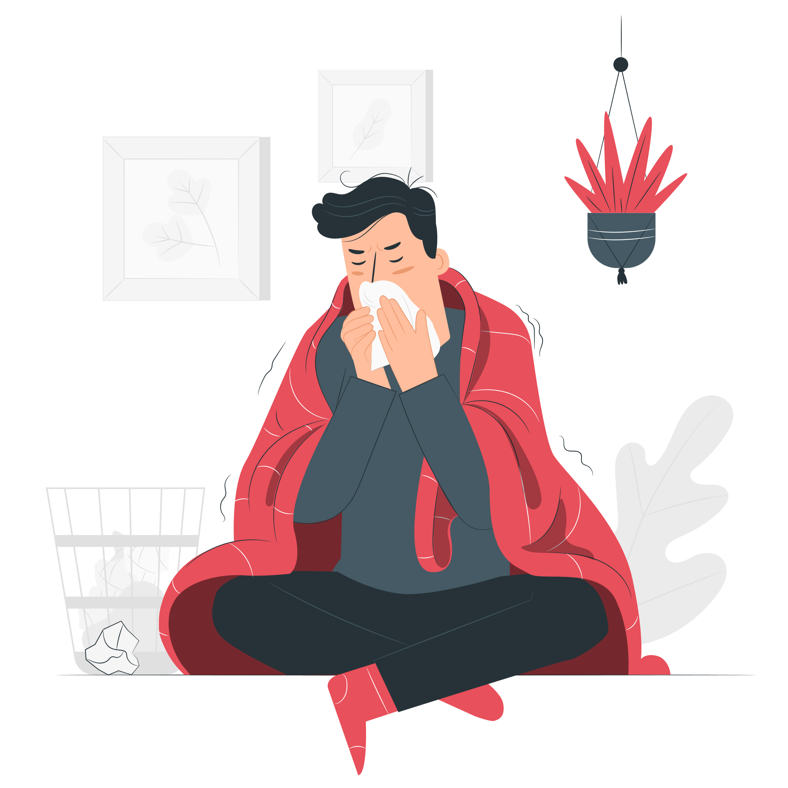
Impact
It will increase the awareness of foodborne illnesses and encourage people to eat healthier.
This software will reduce the number of individuals who fall ill and die of foodborne diseases.
What impact would your solution have?
If the stated problem is solved, how would it improve the lives of the effected users.
This software will notify users of fresh, healthy produce available at nearby supermarkets and stores.

Slide 8
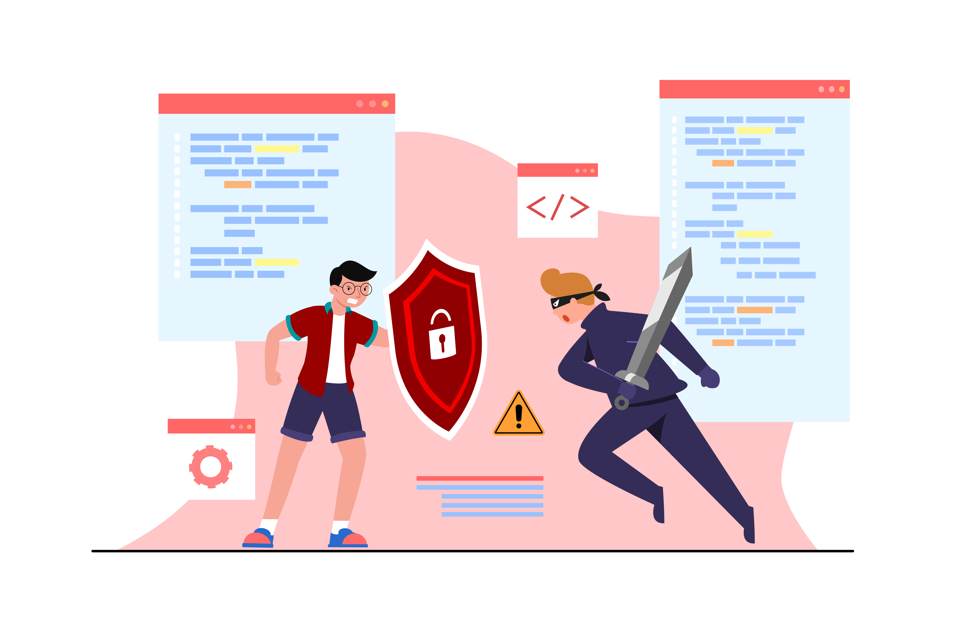
Ethics
Bias Mitigation: The dataset includes foods from all SA cultures (e.g., morogo, bobotie).
Transparency: Explainable AI dashboards in partnership with South African Bureau of Standards (SABS).
Legal compliance: Adhere to South Africa’s data protection laws for user consent and data handling
Human Oversight: It's crucial to have human eyes on the process.

Slide 9

Cybersecurity (Security and Privacy)
Privacy: Federated learning ensures data from townships stays on-device. Compliant with South Africa’s POPIA (Protection of Personal Information Act).
Metadata Scrubbing: Remove any hidden info in the photos, like GPS coordinates or timestamps, that could give away someone's location.
User Consent: Be upfront with users about how their data will be used and get their permission. Give them control over their data, so they can opt out if they want.
AI-Powered Threat Detection: AI can be used to detect and respond to potential security threats in real-time.

